Slide 1
SMART ECO-FRIENDLY GARBAGE MANAGEMENT GENERATING ELECTRICITY
PIP104 University Project-II
VIVA-VOICE
Batch Number:
Roll Number | Student Name
20201CIT0033 | KAVYAKOPPURAVURI
20201CIT0022 | CHANDANAPRIYA G
20201CIT0038 | DEVATHI MANITEJA
20201CIT0016 | GOUTHAM SRIPATHI
Under the Supervision of,
Dr. DIPALI K DAKHOLE
School of Computer Science & Engineering
Presidency University

Slide 2
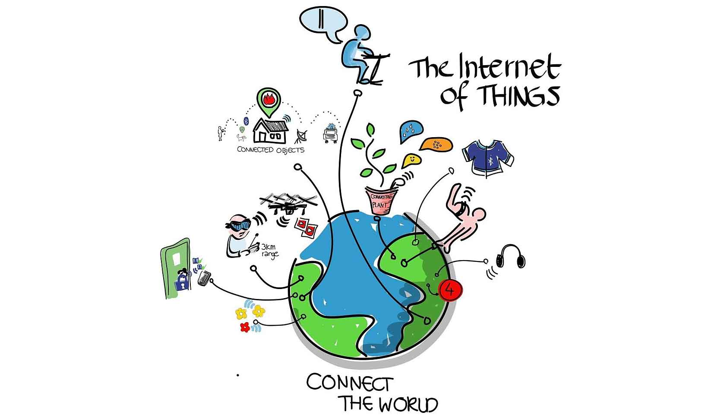
Introduction
INTERNET OF THINGS
IOT is a global infrastructure for information society
Enabling advance services by inter connecting physical and virtual things based on existing and evolving interoperable information and communication
Internet of Things (IoT) is a technology that connects physical objects to the internet. It is used to collect data from sensors and other devices, and then analyze it to gain insights. IoT is used in a variety of industries, such as healthcare, manufacturing, retail, and transportation. It can be used to monitor and control devices remotely, automate processes, and improve efficiency. Major vendors for IoT technology include Amazon, Microsoft, IBM, and Google. These companies provide cloud-based platforms and services that enable businesses to develop and deploy IoT solutions.

Slide 3
LITERATURE REVIEW:
As per our project the literature review:
The integration of IoT technology into waste management systems holds the promise of optimizing waste collection, reducing energy consumption, and generating electricity from waste materials. Various studies have explored the implementation of smart bins and sensors, enabling real-time monitoring of waste levels, which in turn improves the efficiency of waste collection processes in smart cities. Additionally, these IoT-enabled systems have the potential to harness energy from waste materials through technologies like incineration, gasification, and anaerobic digestion. The intersection of IoT and waste management offers a pathway towards more sustainable urban development, promoting efficient resource utilization and renewable electricity generation from

Slide 4
LITERATURE REVIEW
RESEARCH GAPS
Our research gap about the matter of generating electricity using dry & wet waste management Is this waste management explores of innovative technologies and also great & unique idea of the strategies to conduct the collection, sorting, and recycling processes. By understanding this process we can know about the waste management and also understanding environmental And economical impacts of huge dumps of waste seen on the areas in our country by using advanced technologies we can solve this problem of waste management that IOT includes in this solution this research could contribute to more sustainable and efficient waste management practices, and also by addressing this problems can make us growing challenges through the society with increasing urbanization and waste generation.

Slide 5
LITERATURE REVIEW :
NAME | “IOT based intelligent bin for smart cities” | “efficient garbage disposal management in metropolitan” | “smart dustbin” | “smart bin implemented For smart city”
Bin measurement | Yes | Yes | Yes | Yes
Object detection around bin | No | No | No | No
Measuring number of watts produced | No | No | No | No
Time consumption to generate electricity | No | No | No | No

Slide 6
Objectives
Objective 1: Segregation of dry and wet waste.
Objective 2: displaying of flame detected or not detected
Objective 3: The amount of voltage/electricity produced in such
bulb after segregation of production of voltage obtained by dry and wet waste

Slide 7
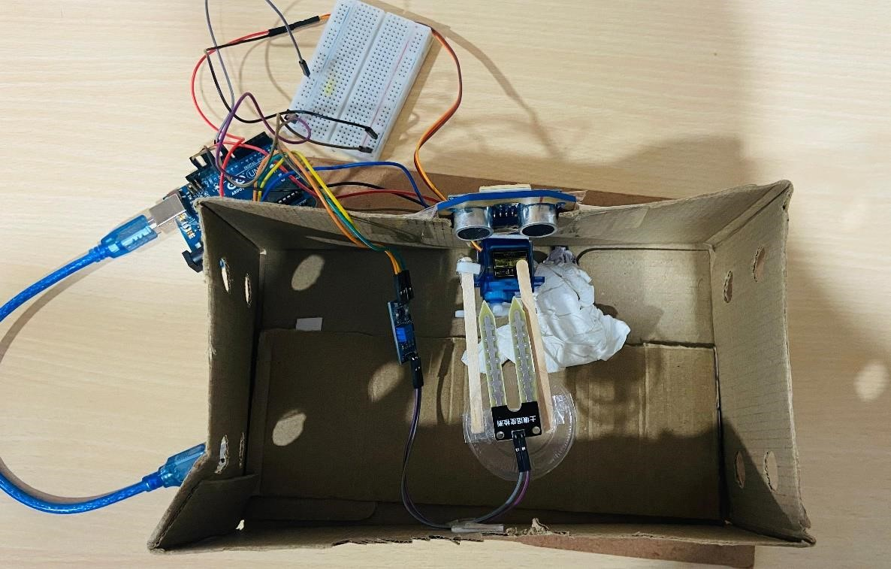
System design and implementation
SYSTEM DESIGN FOR SEGREGATING DRY AND WET WASTE:
In this project we have tried to integrate our normal dustbin with IOT so that we can segregate wet and dry garbage, and it will also indicate whether the garbage is full or not on the website. Here we are using Arduino UNO, along with 1 ultrasonic sensor, 1 servo motor, 1 moisture sensor, and jumper wires.Connect the servo motors, ultrasonic sensors, moisture sensors and to the Arduino uno Upload the code to Arduino uno using Arduino use the dustbin , a person needs to press the push button and keep his/her waste on the plate fixed on the servo motors for setting up soil moisture sensor with Arduino using LM393 comparator. In this project we need to connect only 3 pins of LM393 comparator with Arduino i.e. Vcc ,GND, AO after the connection the working of that segregation is done through the servo motor and ultrasonic sensor and soil moisture sensor once we place the waste on the top of the soil moisture sensor it will detect dry or wet then it will segregate dry waste fall on the right side then wet waste fall on the left side so it will be segregated through the soil moisture sensor

Slide 8
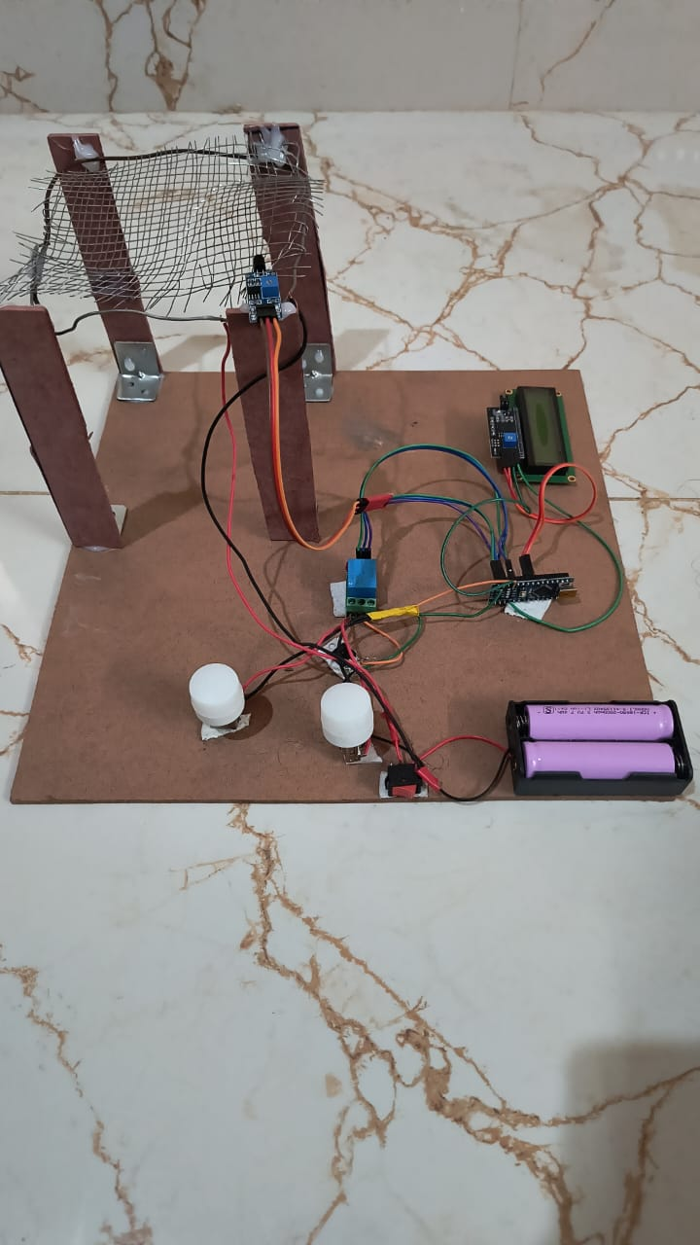
System design and implementation
System design for generating electricity using dry and wet waste:
In this system, a flame sensor positioned near the combustion source detects the presence of a flame, relaying this information to an Arduino Nano through a designated pin. The Arduino program interprets the sensor data, activating an LED for visual confirmation and simultaneously displaying relevant messages such as "Flame Detected" or "No Flame" on an LCD display.
The Arduino also controls a relay, ensuring that the electricity generation process, represented by a connected generator, is initiated only when a flame is detected. This setup enhances safety by preventing the generator from operating in the absence of a flame.
The logic in the Arduino program incorporates checks and delays to mitigate rapid on/off switching due to minor sensor fluctuations, providing a stable and efficient electricity generation system responsive to the flame sensor input. And also in this after the combustion of the dry and wet waste that the biogas will be converted into the electricity and the external biogas will be stored into the batteries and the used to the further level of generating electricity and then when we on the switch that switch connected to batteries after on the switch then the batteries will produce the stored biogas and generates the electricity through the burned waste of dry and wet.

Slide 9
Methodology
Components and Sensors:
IoT Devices: Use IoT devices like Raspberry Pi, Arduino, or dedicated IoT development boards as the core of your system.
Servomotors: These will control waste bin lids for segregation.
Ultrasonic Sensors: These sensors measure the fill level of waste in the bins
Soil Moisture Sensors: These sensors are essential for measuring the moisture content in organic (wet) waste.
Hardware Setup:
Connect the ultrasonic sensors to the IoT device. Place these sensors inside or on the waste bins to measure the fill levels.
Attach the servomotors to the lids of the waste bins. These servomotors will open or close the lids based on the waste type.
Install soil moisture sensors in the bins designated for wet waste to measure moisture levels.

Slide 10
Methodology
Data Acquisition and Sensor Calibration:
Calibrate the ultrasonic sensors to accurately measure the fill levels in the bins. Ensure they can distinguish between full, partially full, and empty states.
Calibrate the soil moisture sensors to detect the moisture content in wet waste accurately.
Servo Control:
Program the IoT device to control the servomotors for the waste bin lids. The servos will open for dry waste and close for wet waste, and vice versa.
Use decision logic in your code that depends on the data analysis results to control the servomotors.
This methodology outlines the key steps to implement an IoT-based dry and wet waste segregation system with servomotors, ultrasonic sensors, and soil moisture sensors. Proper planning, calibration, and testing are crucial for the system's accuracy and effectiveness

Slide 11
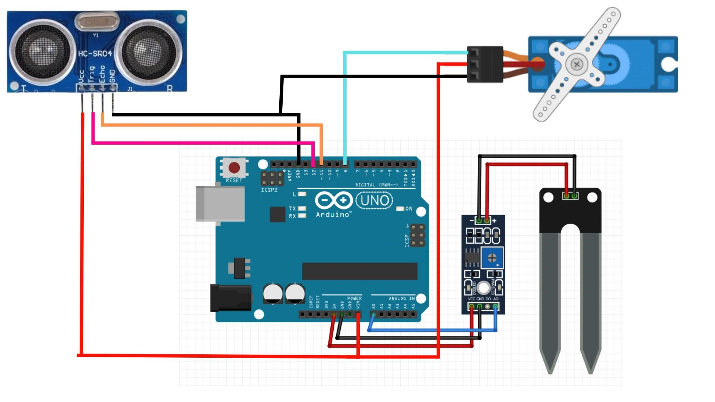
Architecture diagram part-1

Slide 12
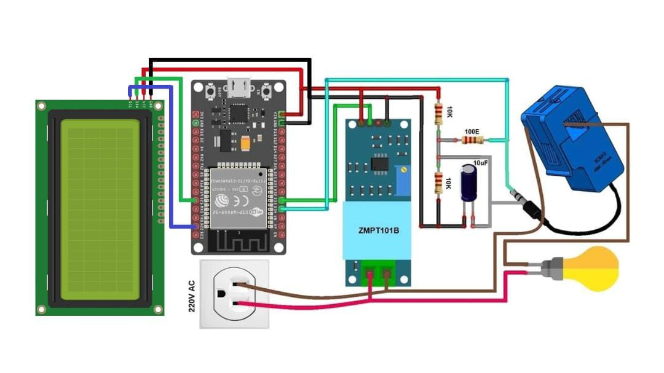
Architecture diagram part -2

Slide 13
Methodology
Components and Sensors:
IoT Devices: Use IoT devices like Arduino, or dedicated IoT development boards as the core of your system.
Flame sensor: the device that detects the presence or absence of a flame in a given system.
Arduino nano(1.8.19): small and versatile and micro controller board 8.0.19 which provides digital and analog I/O pins
Lcd display: it provides visual feedback or information of real data sensor readings other info from Iot devices
Leds
Batterys
Relay: relay is an electro mechanical switch use to control the voltage
I2C module: ( inter integrated circuit) serial communication protocol that can connect low –speed devices . It is a master slave communication .in which we can connect and control multiplke slaves from a single master.

Slide 14
Methodology
WORKING :
In this system, a flame sensor positioned near the combustion source detects the presence of a flame, relaying this information to an Arduino Nano through a designated pin.
The Arduino program interprets the sensor data, activating an LED for visual confirmation and simultaneously displaying relevant messages such as "Flame Detected" or "No Flame" on an LCD display.
The Arduino also controls a relay, ensuring that the electricity generation process, represented by a connected generator, is initiated only when a flame is detected. This setup enhances safety by preventing the generator from operating in the absence of a flame.
The logic in the Arduino program incorporates checks and delays to mitigate rapid on/off switching due to minor sensor fluctuations, providing a stable and efficient electricity generation system responsive to the flame sensor input.

Slide 15
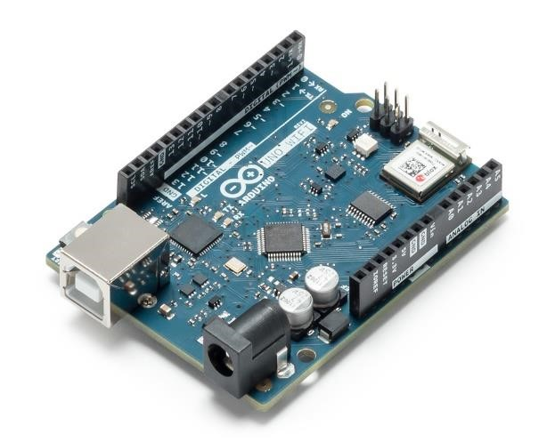
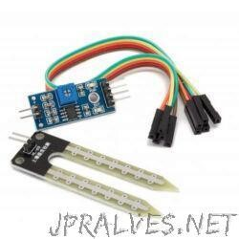
Hardware details
1.Arduino uno R3:($700) cable($75):
The term Uno means “one” in the language of “Italian” and was selected for marking the release of
Arduino IDE 1.0 software. The R3 Arduino Uno is the 3rd as well as most recent modification of the Arduino Uno. Arduino board and IDE software are the reference versions of Arduino and currently progressed to new releases.
2.Soil moisture sensor($150):
In our project we have implemented an IOT based smart waste segregation systemThingSpeak and Webhooks from IFTTT are used to obtain the status of the bins and soil moisture sensor to segregate dry and wet waste.

Slide 16
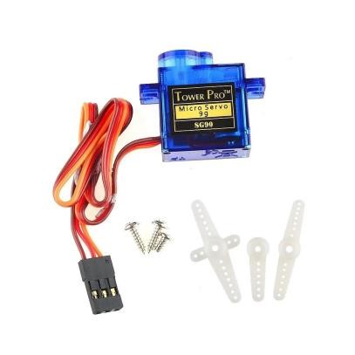
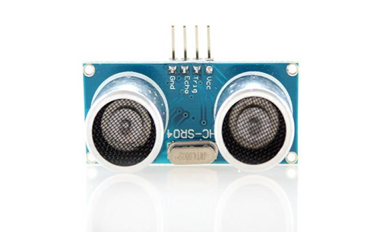
Hardware details
Ultrasonic sensor
An ultrasonic sensor is an instrument that measures the distance to an object using ultrasonic sound waves. An ultrasonic sensor uses a transducer to send and receive ultrasonic pulses that relay back information about an object's proximity
Servo motor($170):
A servo motor is a type of electric motor that can rotate or move to a specific position, speed, or torque based on an input signal from a controller.modern servo motors are capable of providing high performance and precision as main drives in various applications.

Slide 17
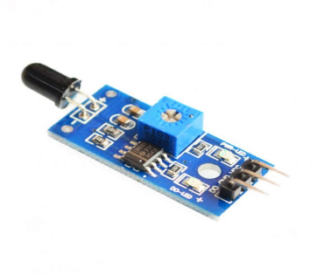
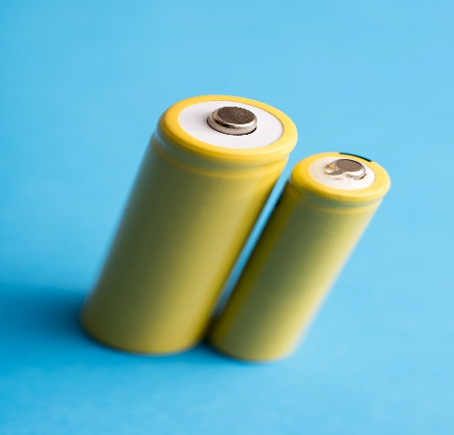
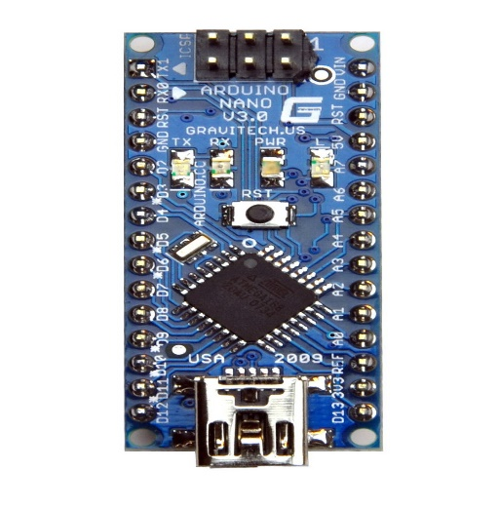
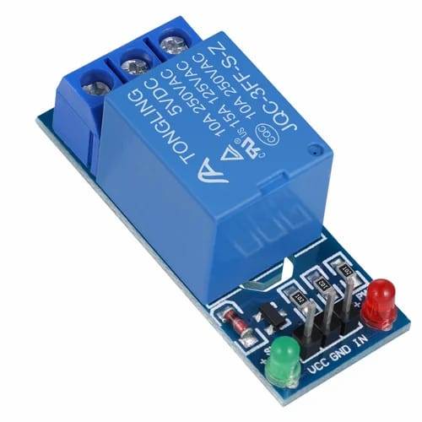
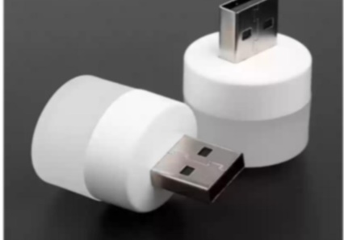
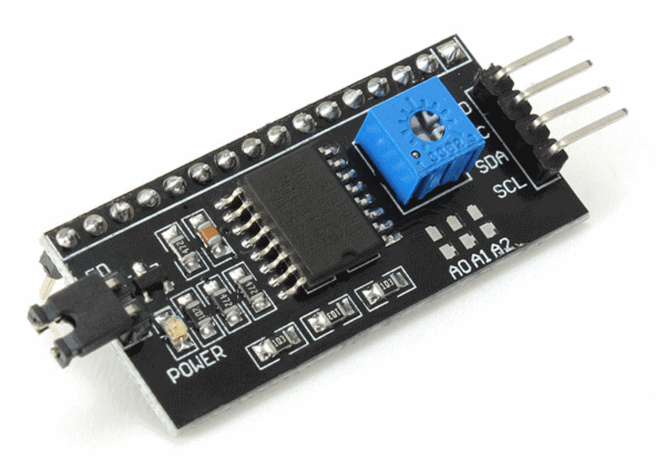
HARDWARE DETAILS
Flame sensor:
Battery’s:
Arduino nano
(1.8.19) version:
Relay:
Led’s:
I2Cmodule:
This Photo by Unknown Author is licensed under CC BY-NC

Slide 18

RESULTS
Segregation of dry and wet waste

Slide 19
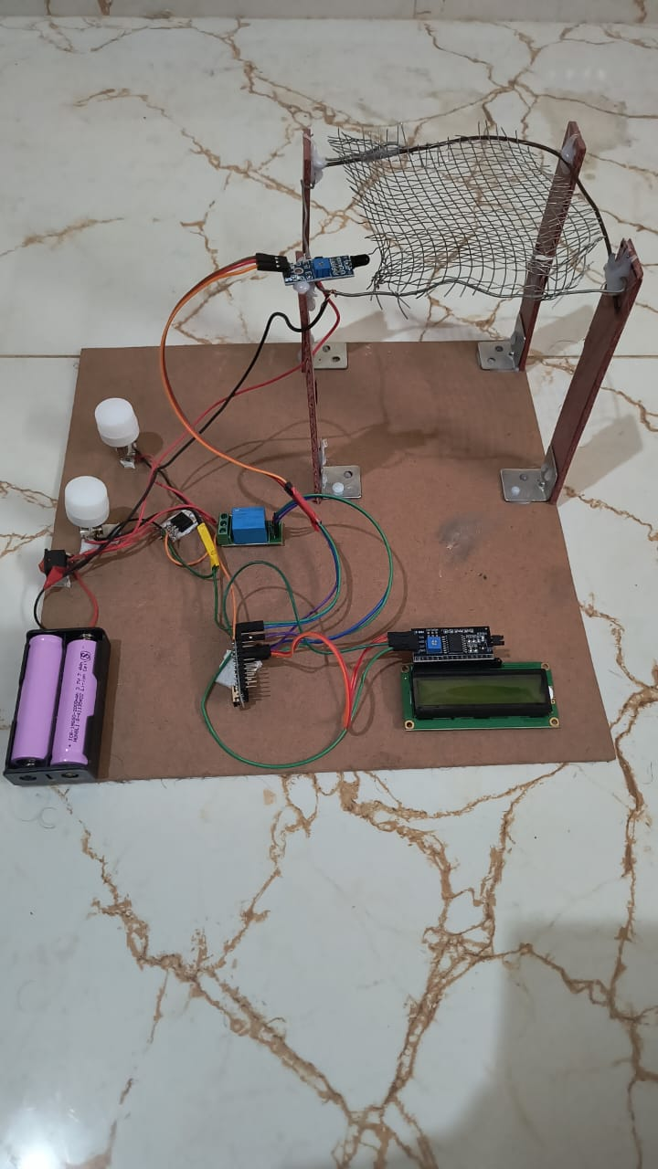
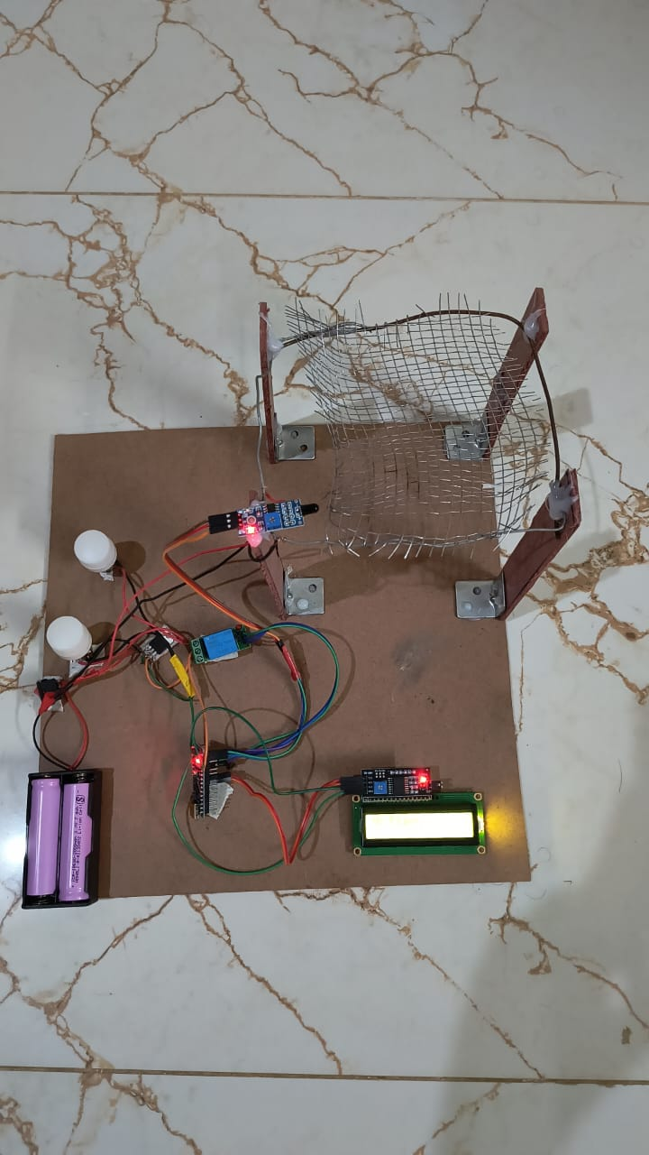
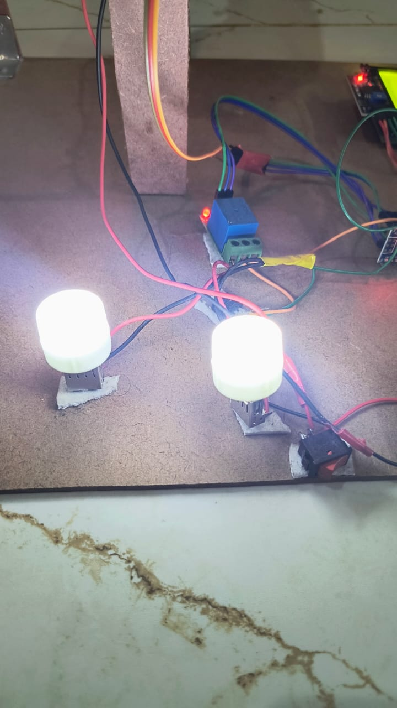
RESULTS
Before assemble After assemble Electricity generated

Slide 20
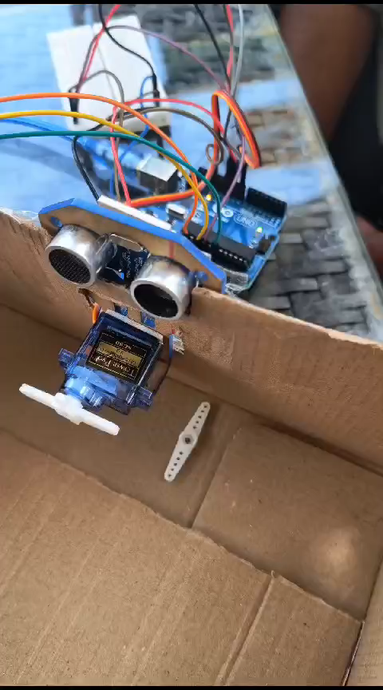
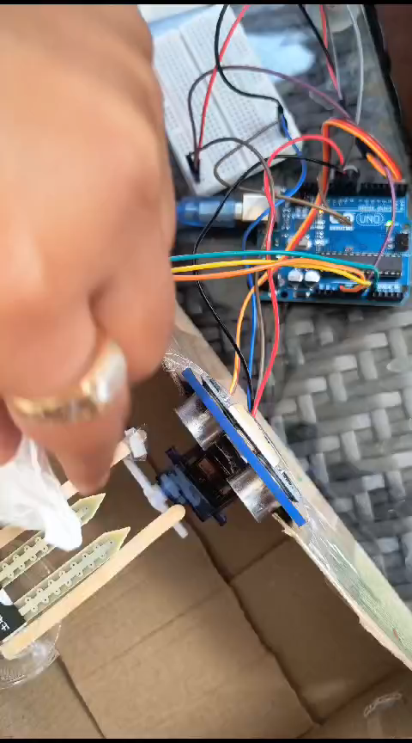
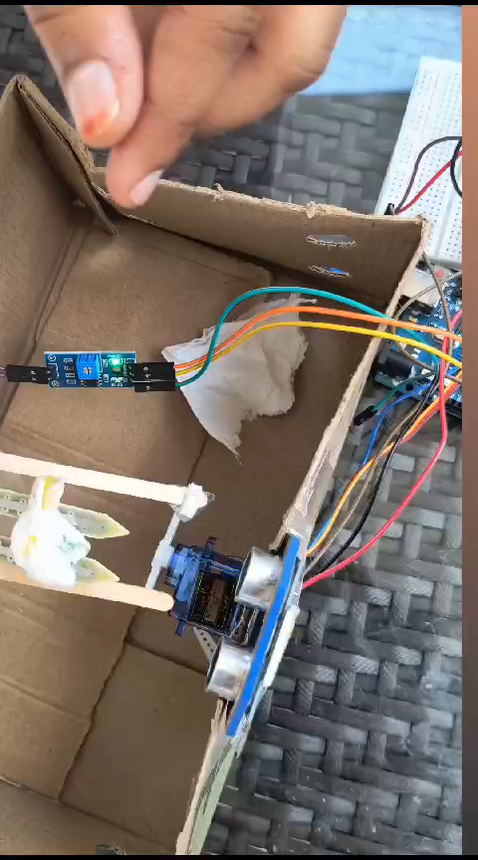
RESULTS

Slide 21
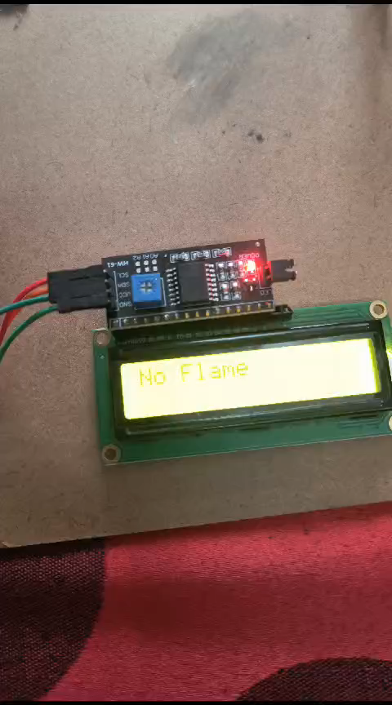
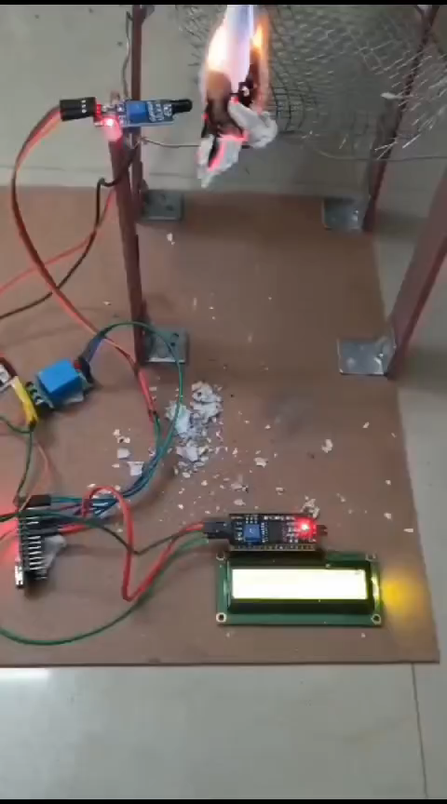
RESULTS

Slide 22
Conclusion
In This Project we show How to Generate Electricity by waste materials is successfully and we show in project how to control pollution by Pollution control filter , When we making complete our project then we check it's full working ,that time he's working is very good without any problem So our Project is best for working and Showing , How to Generate Electricity by Waste materials .From this project we generate electrical energy from waste material with minimum pollution is about 50%.Because of this project 1250 hectares of land is save of wastage. As compare to thermal power plant it generate less pollution is a

Slide 23
Future Scope
From this project we generate electrical energy from waste material with minimum pollution is about 50%.Because of this project 1250 hectares of land is save of wastage. As compare to thermal power plant it generate less The Automatic waste management system may be a leap forward to create the manual assortment and segregation of wastes automatic in nature. The developed system would pioneer work for solid waste management and segregation processes. This proposal for the management of wastes is economical associate degree time saving method than the presently using methodology within which involved municipal worker 101 must seek for the crammed waste bins manually across totally different spots in an area/street for checking often whether or not the waste bin is crammed or not, that is advanced and time taking. This automation of waste conjointly reduces the human effort and consequently the price of the entire method. This technique will be enforced at anywhere with ease and among affordable quantity of your time. The implementation prices for the automation are additionally reasonable

Slide 24
Timeline of Project
S. No. | Review(Offline) | Dates
1 | Review-0 | 09-Oct-2023 to 13-Oct-2023
2 | Review-1 | 06-Nov-2023 to 10-Nov-2023
3 | Review-2 | 27-Nov-2023 to 30-Nov-2023
4 | Review-3 | 26-Dec-2023 to 30-Dec-2023
5 | Final Viva-Voce | 08-Jan-2023 to 12-Jan-2023

Slide 25
References
[1] S. Musorov, D. S. Chertikhina, S. N. Torgaev, T. G. Evtushenko, O. A. Kozhemyak, Control System for Peltier Element Air Dryer-2014, International Conference on Mechanical Engineering, Automation and Control Systems (MEACS), I Tomsk Polytechnic University, 978-1 -4799- 6221- 1/14/$31.00 ©2014 IEEE.
[2] Allwin Jose, Alan D’souza, Sarvesh Dandekar, Jitesh Karamchandani, Pavan Kulkarni, Air Conditioner using Peltier Module, 2015 International Conference on Technologies for Sustainable Development (ICTSD-2015), 978- 1-4799- 81878/15/$31.00 ©2015 IEEE.
[3] Takafumi Hatano, Mingcong Deng, and Shin Wakitani, A Cooling and Heat-retention System Actuated by Peltier Device Considering Fan-motor Control, 2014 IEEE International Conference on Automation Science and Engineering (CASE) Taipei, Taiwan, August 18- 22, 2014, 978-1-4799-5283-0/14/$31.00 ©2014 IEEE.
[4] Saket Kumar, Ashutosh Gupta, Gaurav Yadav, Hemender Pal Singh, Peltier Module for Refrigeration and Heating using Embedded System, 2015 International Conference on Recent Developments in Control, Automation and power.

Slide 26

Thank You

